Slide 1

6th Grade Math
Unit 1, Lesson 4 Dividing Fractions Volume 1, pg. 19

Slide 2


Benchmark
MA.5.AR.1.3
Solve real-world problems involving division of a unit fraction by a whole number and a whole number by a unit fraction.
volume 1, pg. 19

Slide 3
Integrated Mathematical Thinking and Reasoning Standards
MA.K12.MTR.1.1 Actively participate in effortful learning both individually and collectively.
MA.K12.MTR.2.1 Demonstrate understanding by representing problems in multiple ways.
MA.K12.MTR.4.1 Engage in discussions that reflect on the mathematical thinking of self and others.
MA.K12.MTR.5.1 Use patterns and structure to help understand and connect mathematical concepts.
MA.K12.MTR.7.1 Apply mathematics to real-world contexts.
volume 1, pg. 19

Slide 4


Learning Target
I can represent division of fractions with an appropriate model.
volume 1, pg. 19

Slide 5

Warm-Up
volume 1, pg. 19

Slide 6
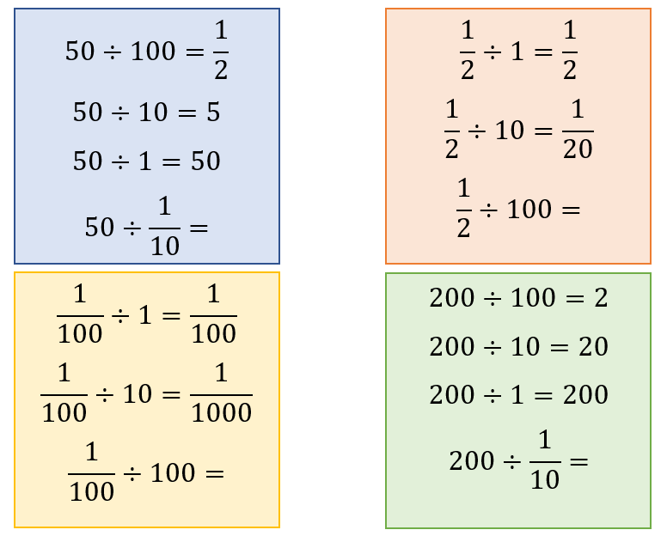
1.4.1 Warm-Up: Notice and Wonder
There are four patterns of division. The last problem in the pattern does not have a quotient.
volume 1, pg. 19

Slide 7
What do you notice about the patterns?
What do you wonder about the patterns?
Use the pattern to guess what the missing quotient is for each pattern. Write your guess in the box.
volume 1, pg. 19

Slide 8

Collaboration
volume 1, pg. 20

Slide 9

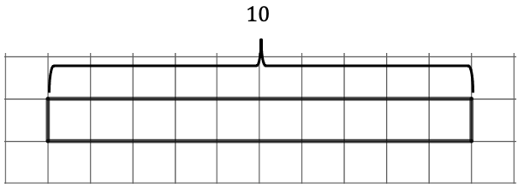
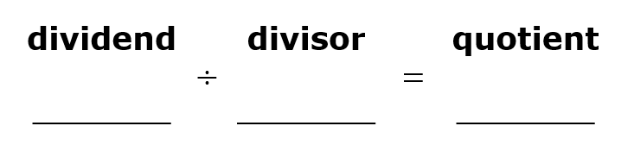

1.4.2 Collaboration: Visual Models of Division
A tape diagram is shown.
Use the diagram to show how many groups of $\frac{1}{2}$ are in 10.
Write the division problem represented by the tape diagram.
volume 1, pg. 20

Slide 10
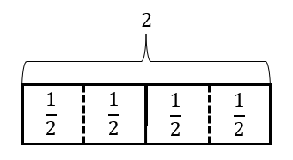
Discuss with your partner how the tape diagram shows that dividing a whole number by a fraction less than 1 will result in a quotient that is greater than the dividend.
A tape diagram is shown.
Write the division equation that is represented by the tape diagram.
volume 1, pg. 20

Slide 11
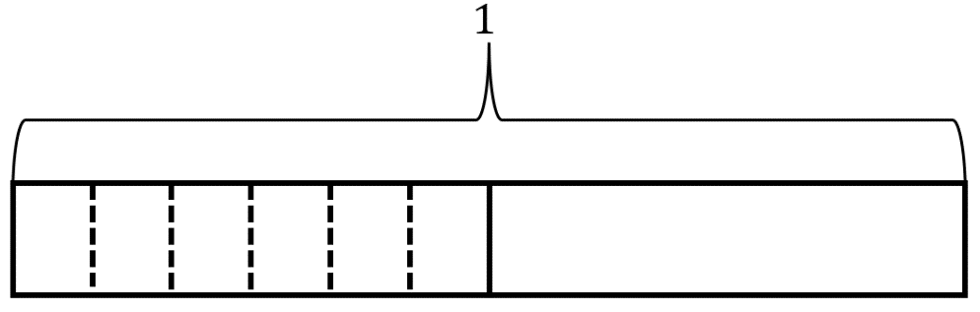
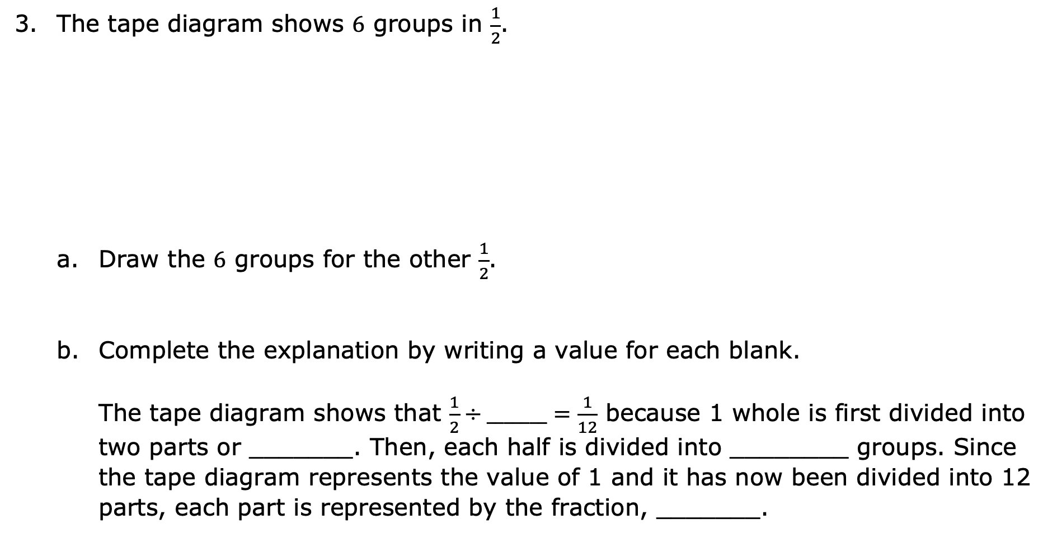
The tape diagram shows $6$ groups in $\frac{1}{2}$.
Draw the $6$ groups for the other $\frac{1}{2}$.
Complete the explanation by writing a value for each blank.
The tape diagram shows that $\frac{1}{2}÷_______=\frac{1}{12}$ because 1 whole is first divided into two parts or _______. Then, each half is divided into ________ groups. Since the tape diagram represents the value of 1 and it has now been divided into 12 parts, each part is represented by the fraction, _______.
volume 1, pg. 20

Slide 12
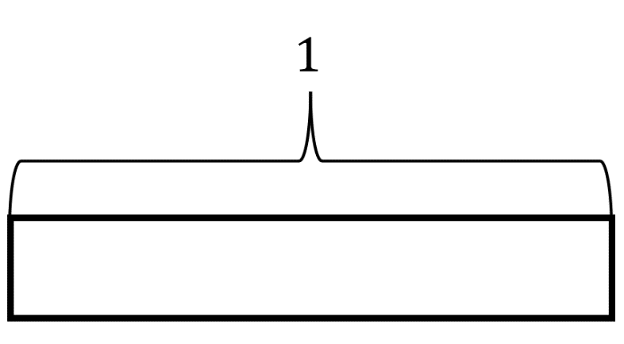

Work with your partner to use the tape diagram to show $\frac{1}{4}÷2$.
The tape diagram shows that the quotient of $\frac{1}{4}÷2$ is ______.
volume 1, pg. 21

Slide 13

Guided Instruction
volume 1, pg. 21

Slide 14
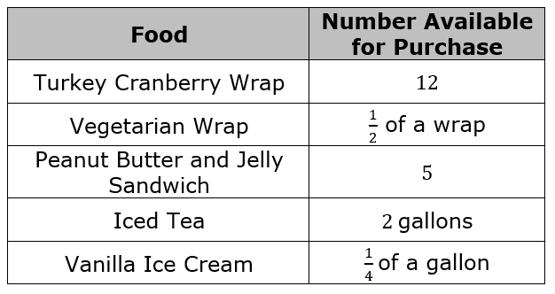
1.4.3 Guided Instruction: Dividing Fractions
The Blue Palmetto Café at Bok Tower Gardens has several items available for purchase so guests can enjoy a meal after touring the gardens. Before the gardens opened for the day, the chef took inventory of the food on hand.
volume 1, pg. 21

Slide 15
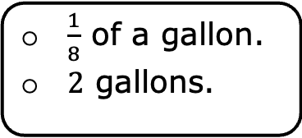
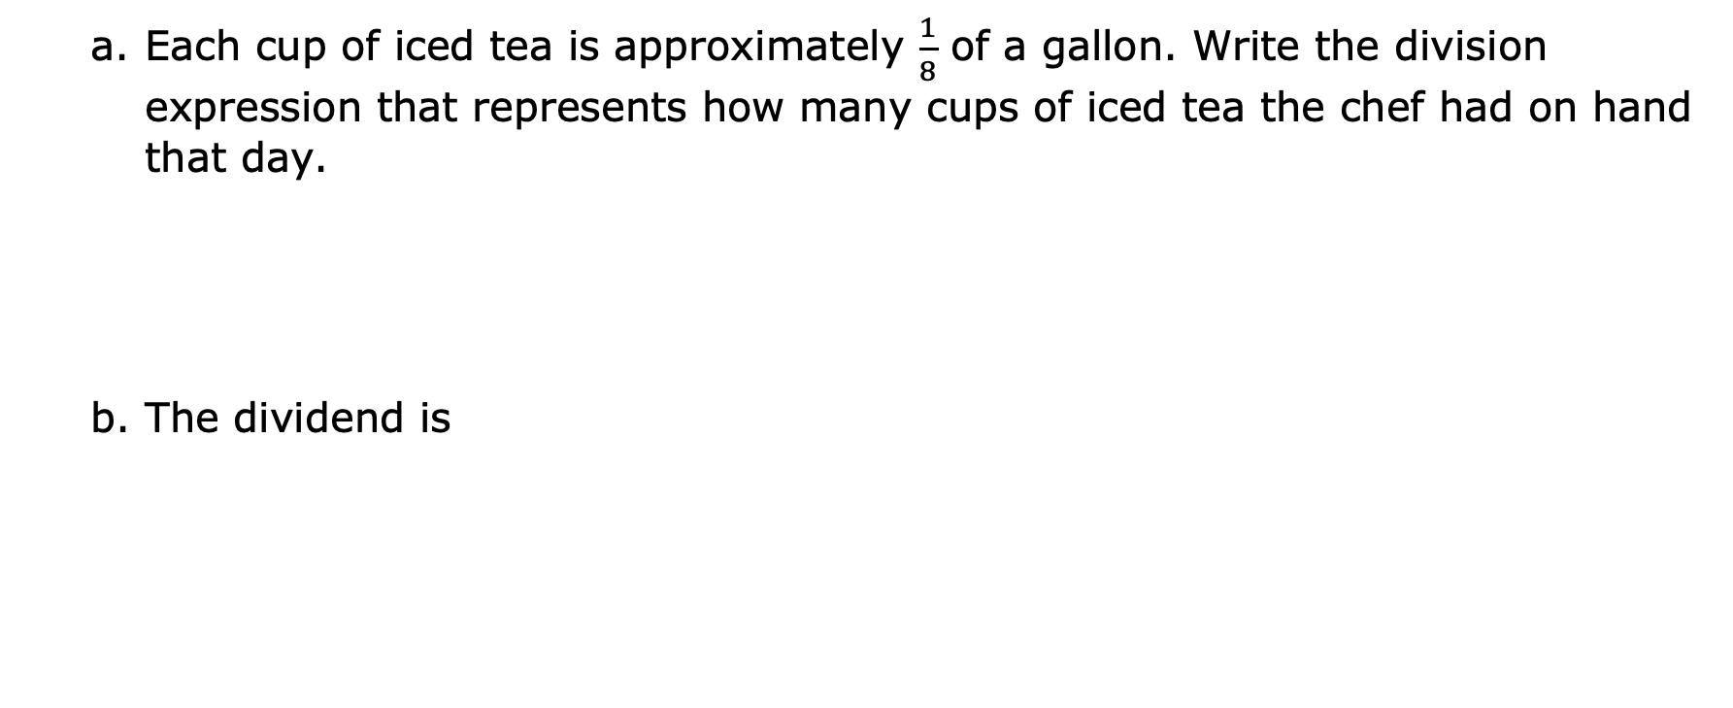
Each cup of iced tea is approximately $\frac{1}{8}$ of a gallon. Write the division expression that represents how many cups of iced tea the chef had on hand that day.
The dividend is
$\frac{1}{8}$ of a gallon.
2 gallons.
volume 1, pg. 21

Slide 16

When drawing a model to represent the equation, first draw the dividend, or the amount being divided.
c. Draw a model of the dividend.
Then, partition the dividend into equal groups determined by the divisor, or the number that tells the size of each group.
In this problem, the divisor is
Complete your model to show the dividend partitioned into equal groups that are the size of the divisor.
$\frac{1}{8}$of a gallon.
2 gallons.
volume 1, pg. 22

Slide 17
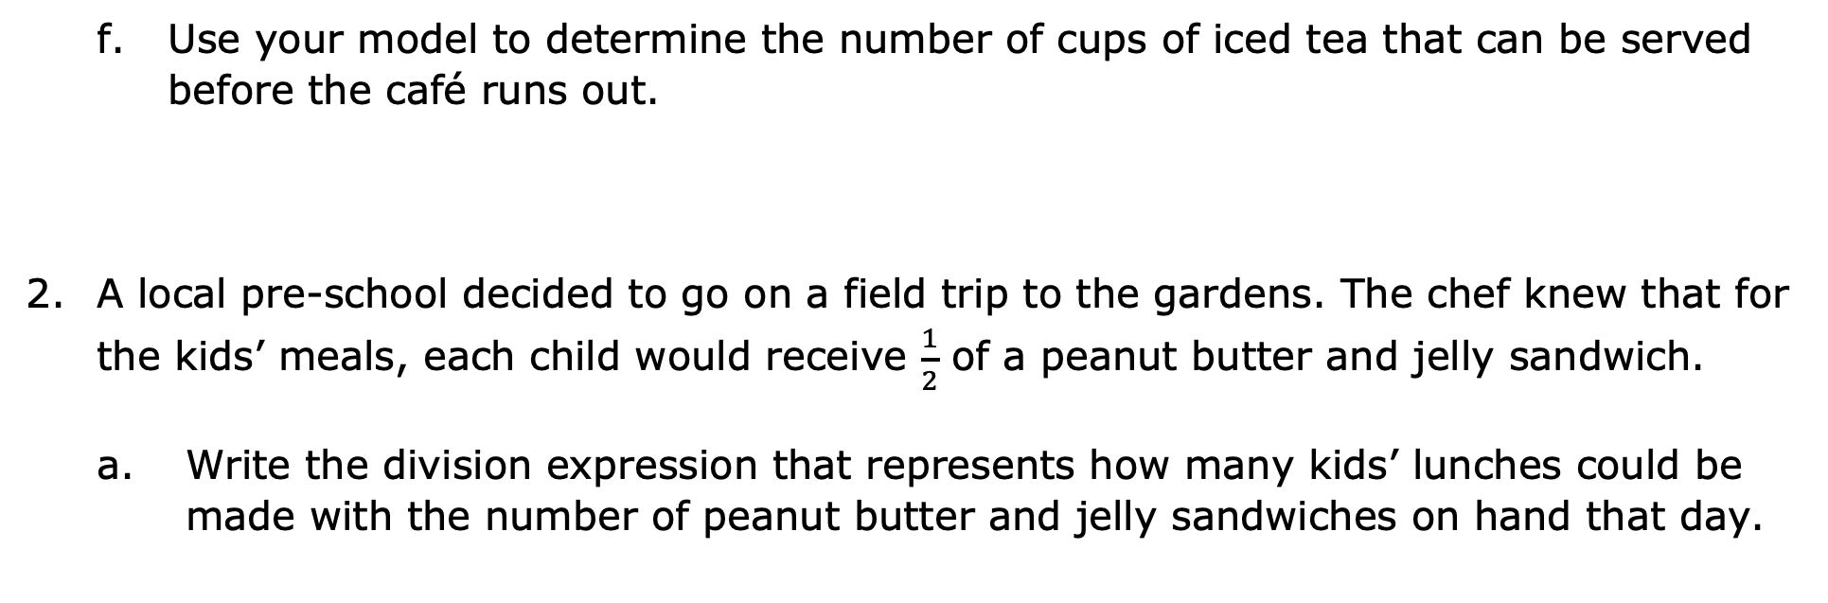
Use your model to determine the number of cups of iced tea that can be served before the café runs out.
A local pre-school decided to go on a field trip to the gardens. The chef knew that for the kids’ meals, each child would receive $\frac{1}{2}$ of a peanut butter and jelly sandwich.
Write the division expression that represents how many kids’ lunches could be made with the number of peanut butter and jelly sandwiches on hand that day.
volume 1, pg. 22

Slide 18
Draw a model that represents the division expression.
Use the model to determine the number of students the chef can serve.
volume 1, pg. 22

Slide 19
Veer’s family was very hot after an afternoon in the gardens. They decided to enjoy some ice cream before they left to go home. All 4 family members ordered vanilla ice cream, causing the chef to run out. How much ice cream did each person get if they each got an equal amount?
Write the division expression that represents the c context.
Draw a model to match your expression.
c. How much ice cream did each person get?
volume 1, pg. 23

Slide 20
Collaboration
volume 1, pg. 23

Slide 21
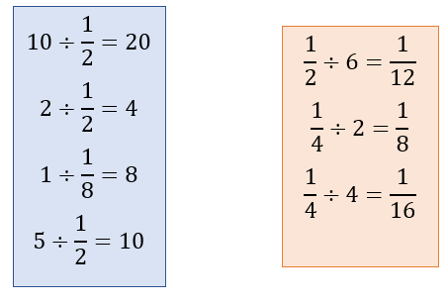
1.4.4 Collaboration: An Algorithm for Dividing Fractions
The boxes show the division equations that have been represented in the lesson so far.
volume 1, pg. 23

Slide 22
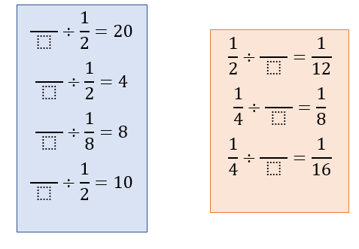
Keeping in mind that a whole number can be written as a fraction, rewrite the division equations in the two boxes.
Charles Babbage is credited with inventing the first mechanical computer. Ada Lovelace was the first to recognize that Babbage’s machine had applications beyond making calculations. She published the first algorithm intended to be carried out by such a machine. As a result, she is sometimes regarded as the first to recognize the full potential of a “computing machine” and the first computer programmer.
volume 1, pg. 23

Slide 23
Work with your partner on an algorithm for dividing fractions.
Write the algorithm as a set of rules to be followed. Use mathematical terms such as divisor and dividend.
Your algorithm should meet the following criteria:
The algorithm uses mathematical terms.
The algorithm works for our test problems.
The algorithm is clear and can help students learn the process of dividing fractions.
volume 1, pg. 24

Slide 24
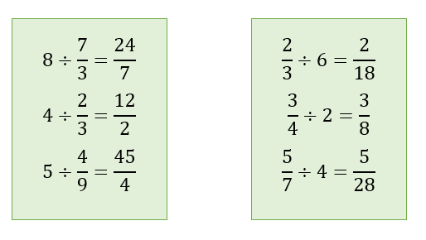
Test your algorithm using the problems shown. If necessary, adjust your algorithm.
If your algorithm worked and did not need adjustment, then show the work that proves that it worked. If your algorithm did not work, remember making mistakes helps you learn. Adjust your algorithm and write the new steps.
volume 1, pg. 24

Slide 25
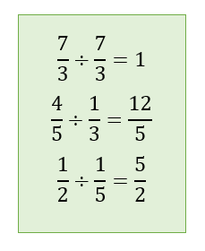
Test your algorithm again or use your new algorithm with the problems shown.
volume 1, pg. 24

Slide 26
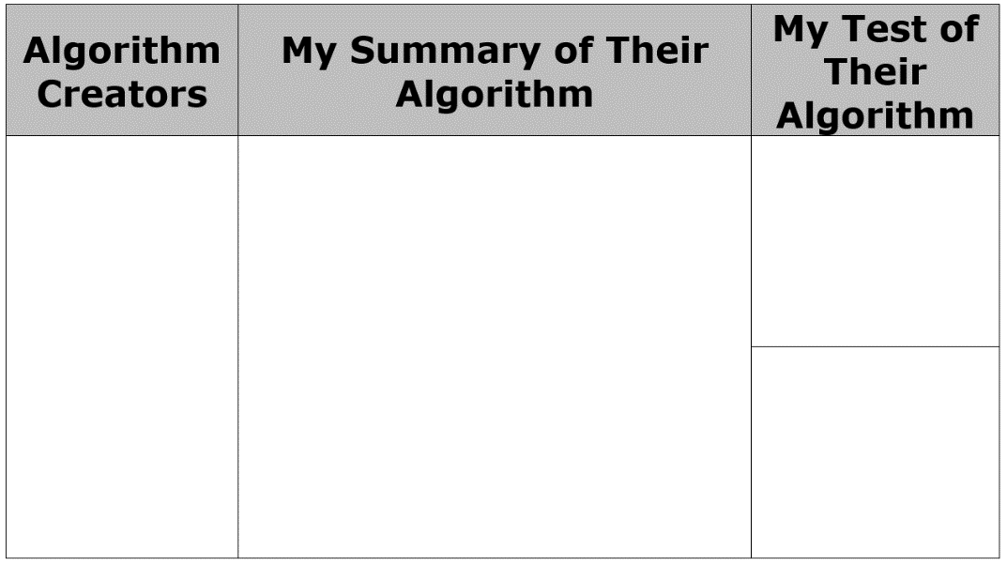
e. Exchange your algorithm with another pair of students.
In the first column, write the names of the students who wrote the algorithm.
In the second column, write your summary of their algorithm.
In the third column, use their algorithm to test any two of the division equations.
volume 1, pg. 25

Slide 27
f. Check the criteria that this algorithm met.
The algorithm uses mathematical terms.
The algorithm works for my test problems.
The algorithm is clear and could help students know the process of dividing fractions.
volume 1, pg. 25

Slide 28

Wrap-Up
volume 1, pg. 25

Slide 29
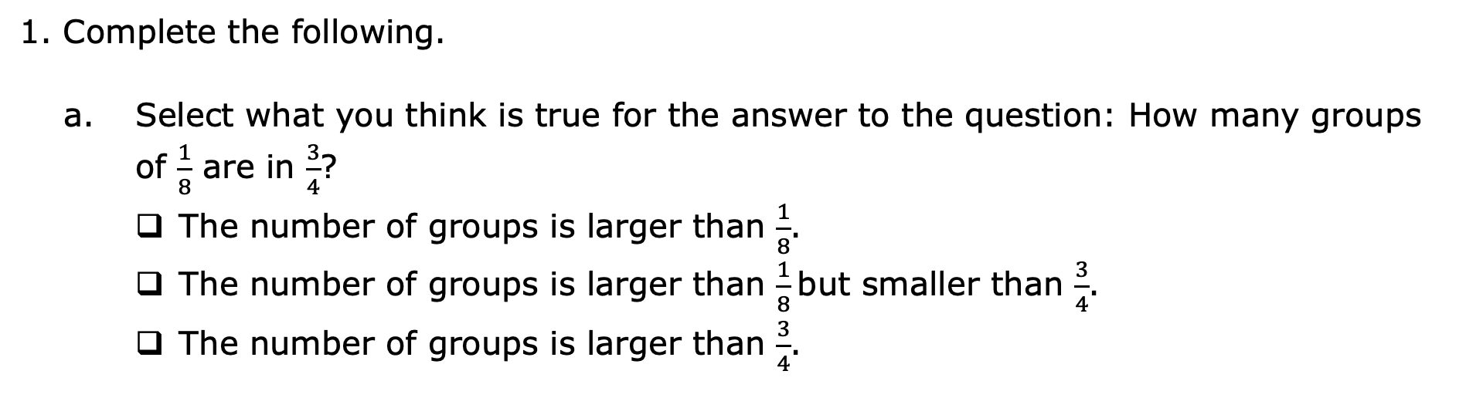
1.4.5 Wrap-Up: Ticket Out the Door
1. Complete the following.
Select what you think is true for the answer to the question: How many groups of $\frac{1}{8}$ are in $\frac{3}{4}$?
The number of groups is larger than $\frac{1}{8}$.
The number of groups is larger than $\frac{1}{8}$but smaller than $\frac{3}{4}$.
The number of groups is larger than $\frac{3}{4}$.
volume 1, pg. 25

Slide 30
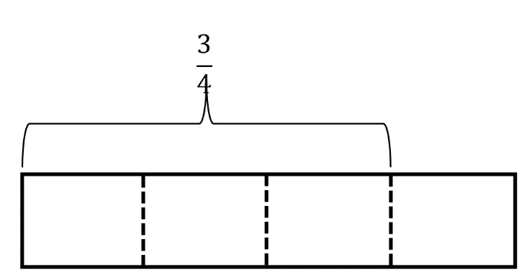

Using a model can help visualize mathematics. Use the tape diagram to determine the number of groups of $\frac{1}{8}$ that are in $\frac{3}{4}$.
Use an algorithm from class today to find $\frac{3}{4}÷\frac{1}{8}$. Show your work.
volume 1, pg. 25

Slide 31
Check all that apply to you.
I prefer to use models for dividing fractions.
I prefer to use an algorithm for dividing fractions.
I do not mind using a model or an algorithm for dividing fractions.
volume 1, pg. 25

